Slide 1
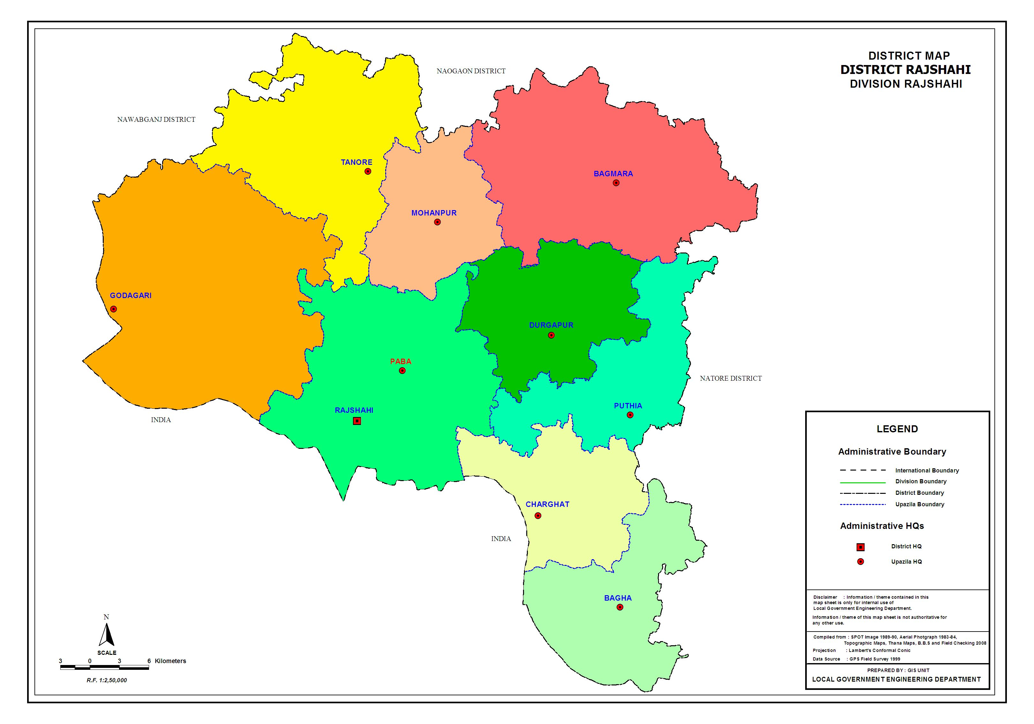
Rajshahi Division

Slide 2
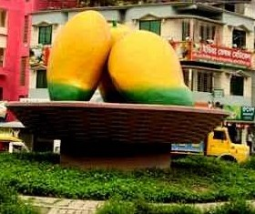
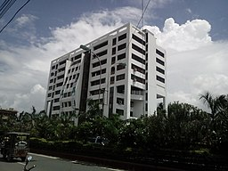
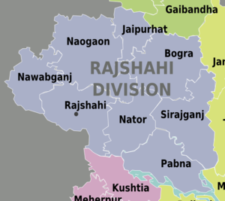
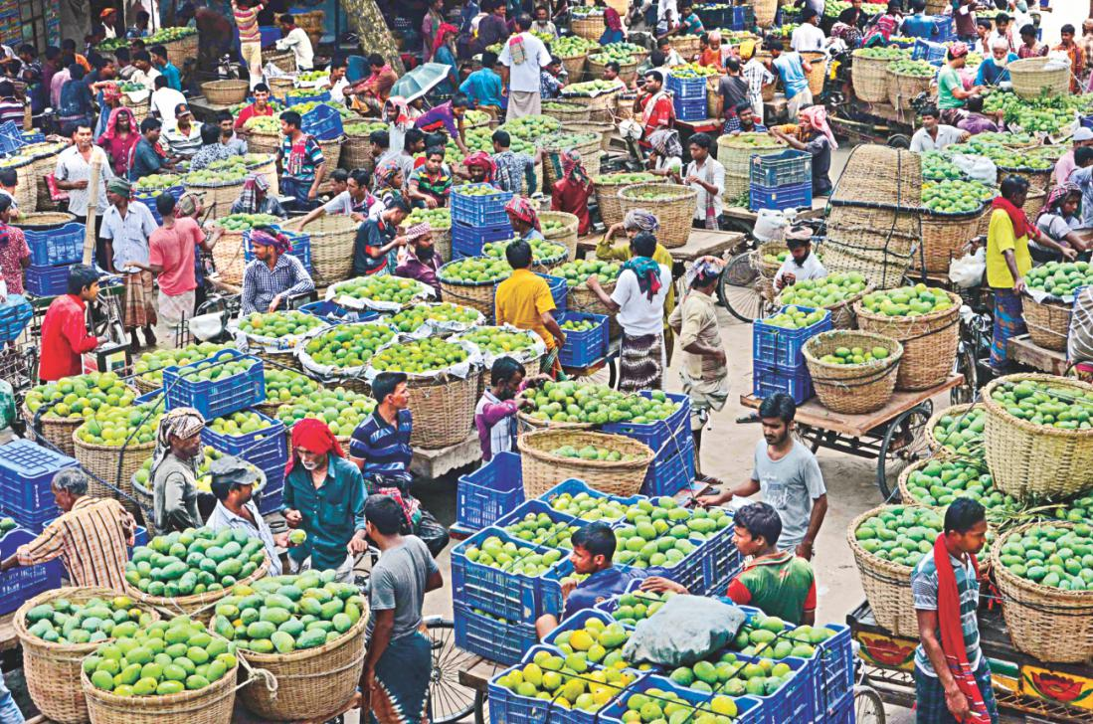
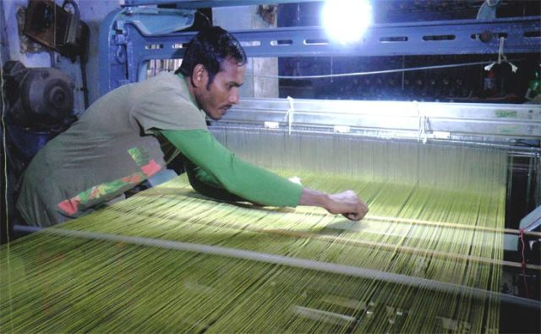
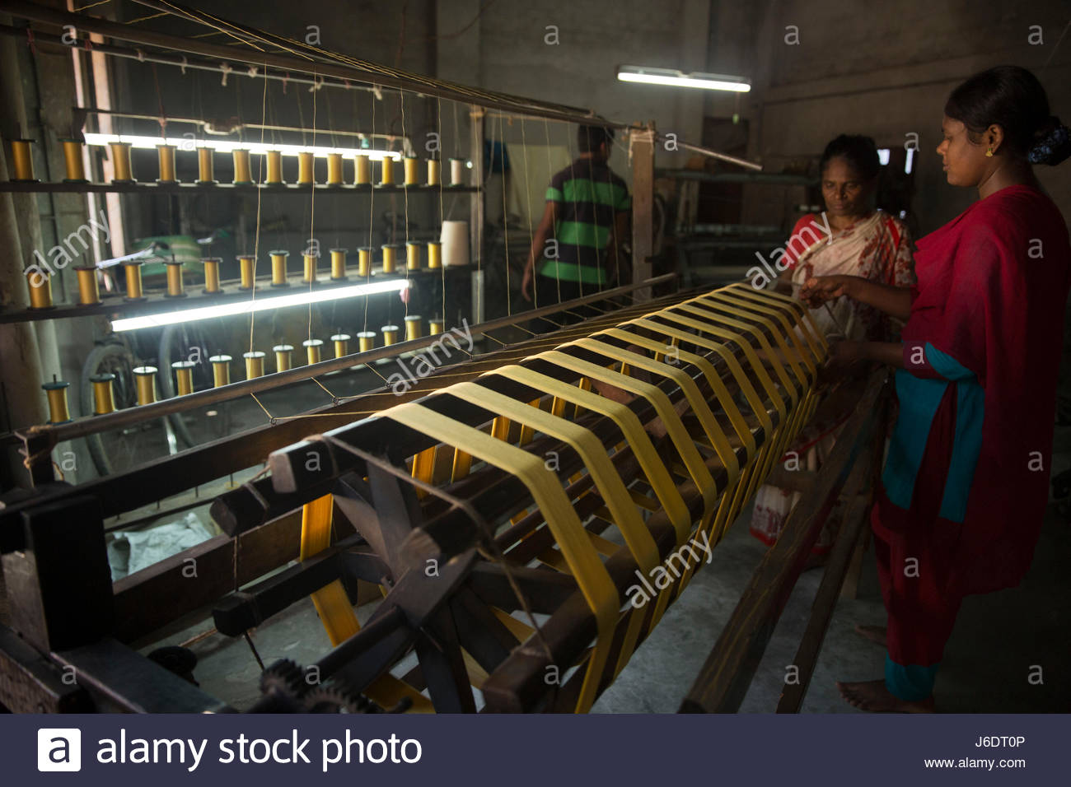
Introduction
Rajshahi is one of the largest divisions in Bangladesh. Rajshahi division is agricultural. It is one of the center of the silk industry.
The region is famous for mangoes, lichis.
For travelers, this division offers a variety of historical monuments, including mosques, temples, rajbaris, and other buildings.
Rajshshi silk Factory

Slide 3
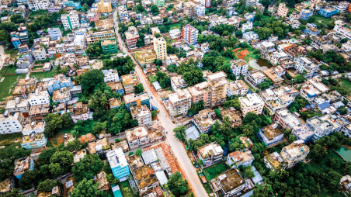
Rajshahi is an important administrative, educational, cultural and Business center in Bangladesh.
Varendra Research Museum, the oldest of its kind in Bangladesh, is located in the city.
Sometimes the city is referred to as the City of Education on account of being home to many renowned educational institutions of Bangladesh.
The head office of Rajshahi Agricultural Development Bank and Barind Multipurpose Development Authority (BMDA) is situated in the city. The Shah Makhdum Airport serves Rajshahi.

Slide 4

LOCATION
Rajshahi division is located in the north-western region of Bangladesh. It is bordered by West Bengal, India, on the north and west.
It is bounded by west Bengal state of India and Dinajpur and Gaibandha districts on the north, Rajbari and kushtia districts on the south, Jamalpur, Tangail and Manikganj districts on the east, West Bengal state of India on the west.
The Padma River forms its southern border, and the Jamuna River is on the eastern boundary.
The famous river Padma borders Rajshahi division on the south and another famous river, Jamuna, lies across the eastern border. In the West, Rajshahi division shares a border with India.

Slide 5
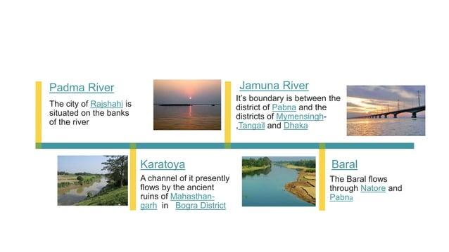

Water Bodies

Slide 6
Population
Population: 20,794,019 Population [2022] – Census
Area: 18,155 km²
Population Density: 1,145/km² [2022]
0.70% Annual Population Change [2011 → 2022]

Slide 7
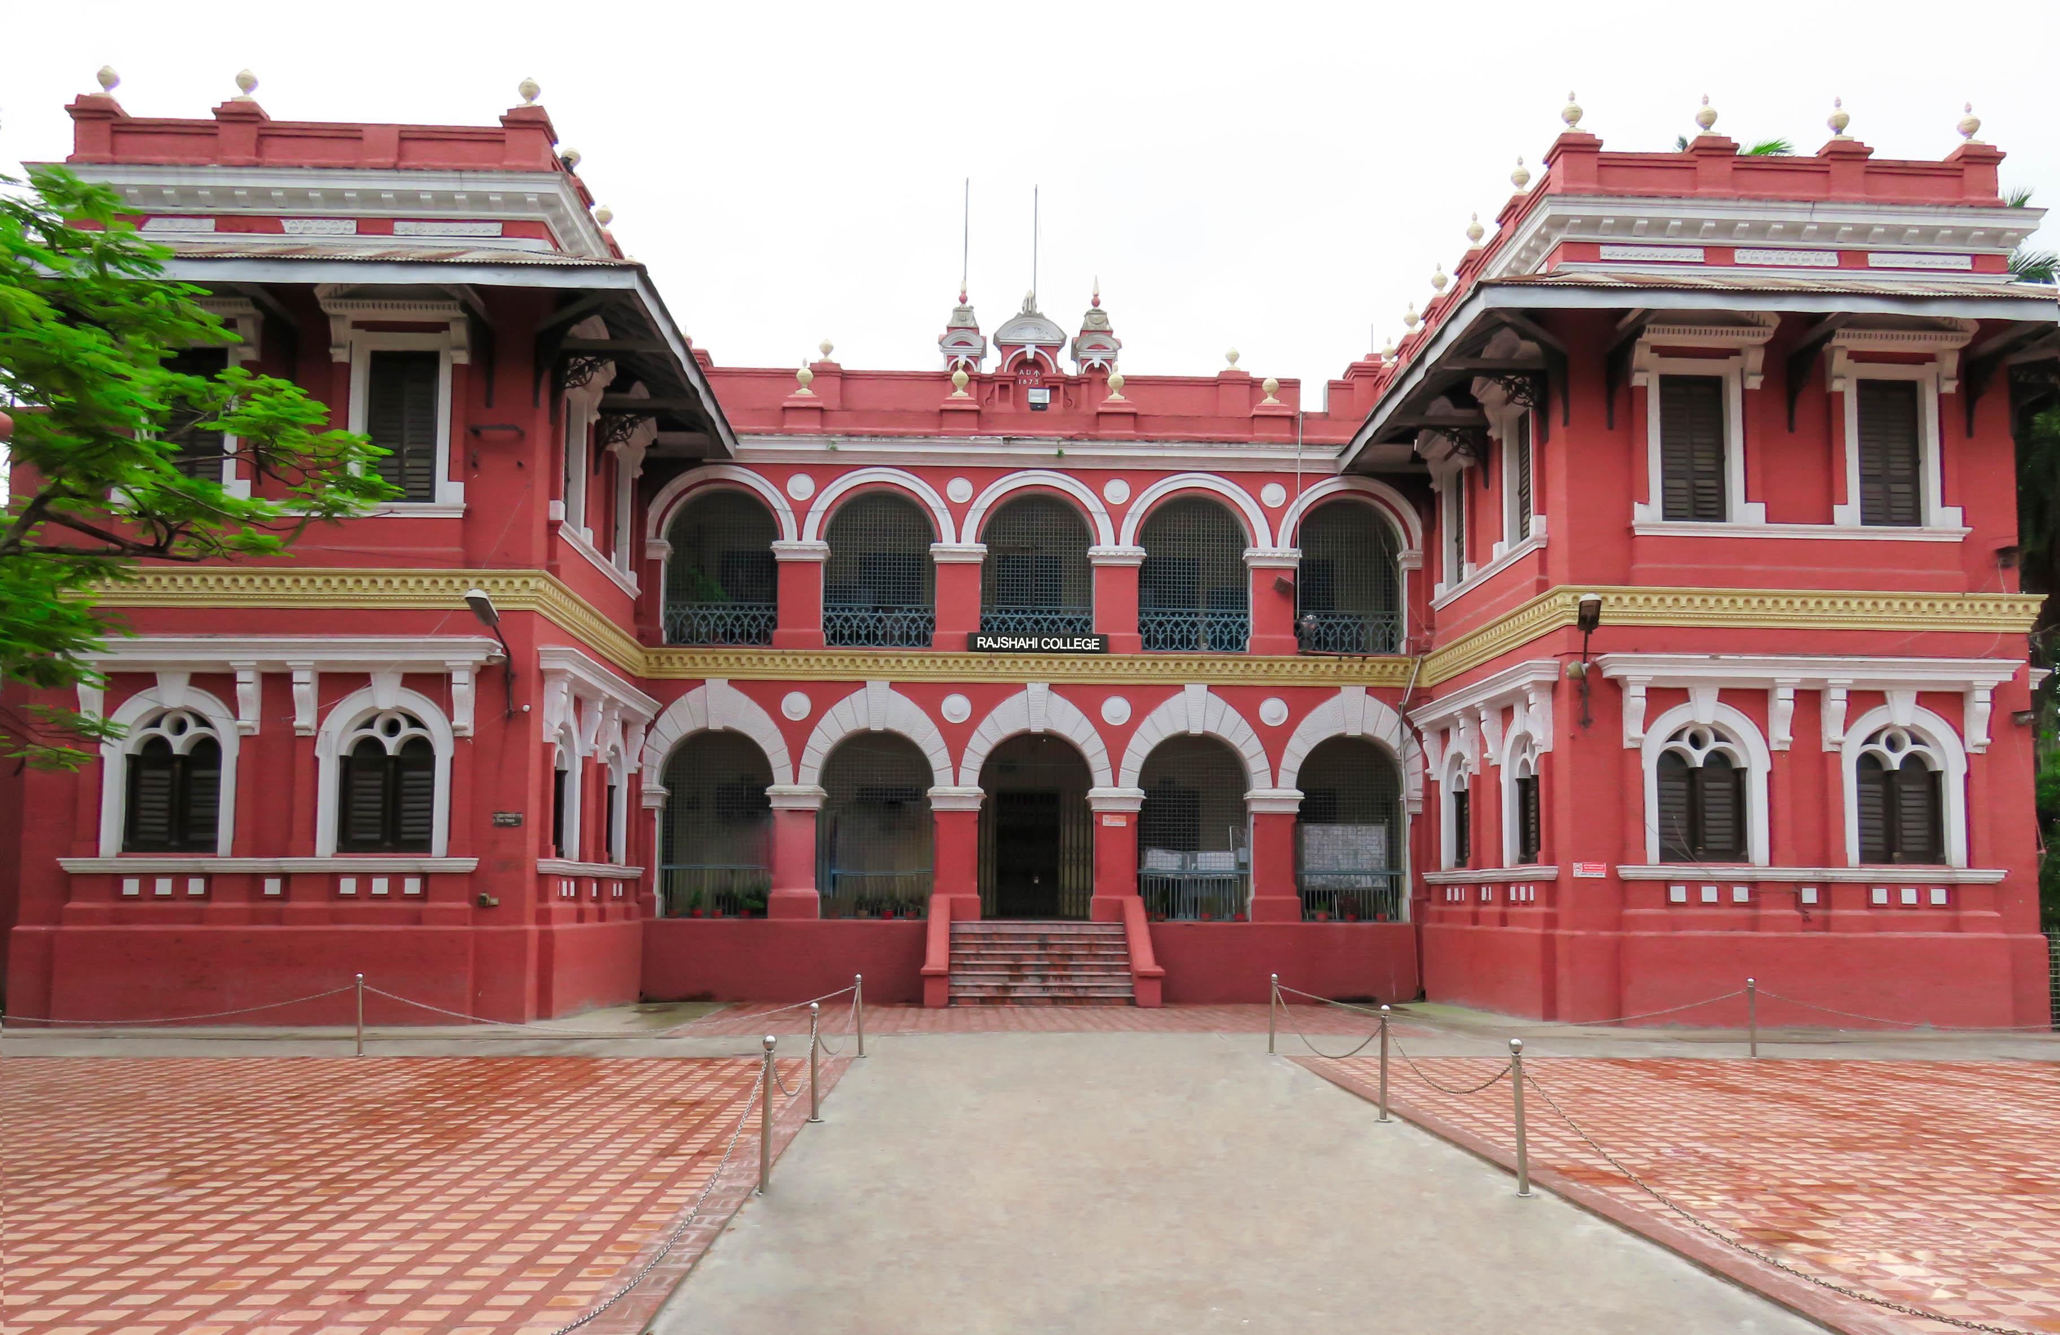
Administratiive Structure
One of the Eight first-level Administrative division.
Consist of 1 City corporation
8 Districts
70 Upazilas
35 Paurasabhas
558 Unions and
297 Wards

Slide 8
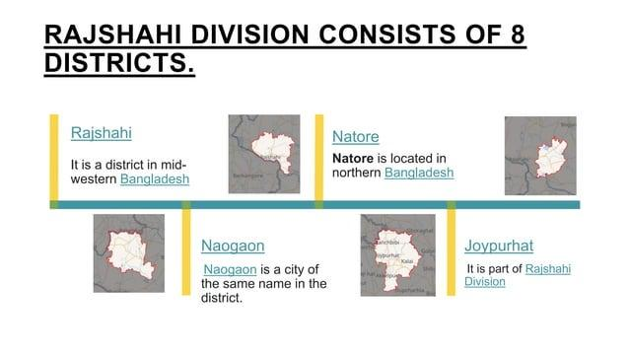

Slide 9
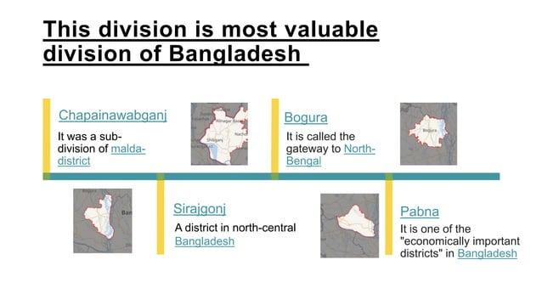

Slide 10
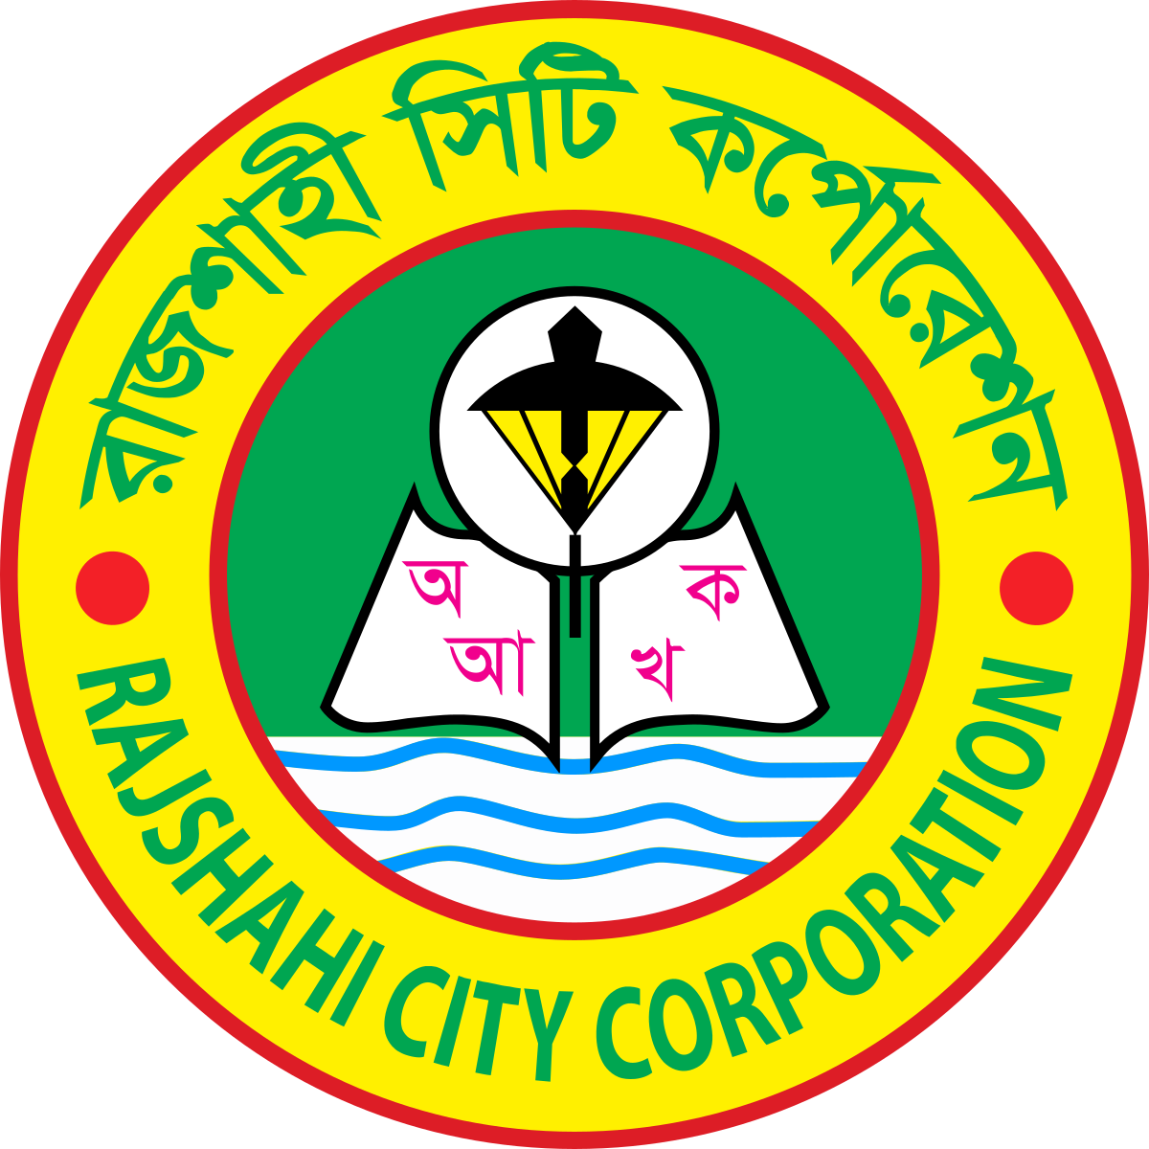
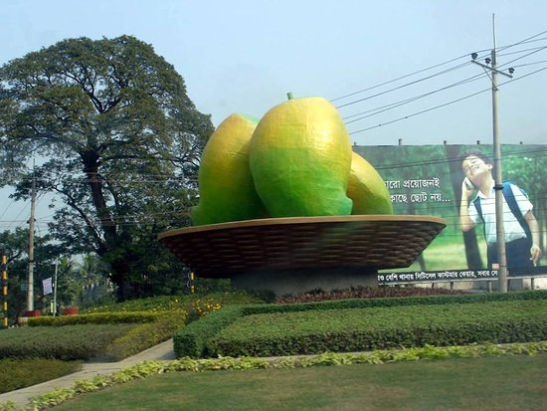
Administration
Munici
Rajshahi Town was established in the eighteenth century.
Rajshahi Municipality was formed in 1876 and it was turned into a City Corporation in 1991.
On 25 January 1910 Rangpur was separated from Rajshahi Division to form a new Division.

Slide 11
Division
Area (sq km) | City corporation | District | Upazila | Paurasabha | Union | Ward | Population |  | Density (per sq km) | Literacy rate (%)
 |  |  |  |  |  |  | Urban | Rural
17974.68 | 1 | 8 | 66 | 58 | 557 | 546 | 3306756 | 15048798 | 1021 | 48.0

Slide 12
District
Name of District | Area (sq km) | Upazila | Municipality | Ward | Mahall | Union | Mouza | Village | Population | Density (per sq km) | Literacy rate (%)
Joypurhat | 1012.41 | 5 | 4 | 36 | 111 | 32 | 636 | 887 | 913768 | 903 | 57.5
Naogaon | 3435.65 | 11 | 3 | 27 | 92 | 99 | 2497 | 2,780 | 2600157 | 757 | 48.2
Nawabganj | 1702.55 | 5 | 4 | 45 | 156 | 45 | 736 | 1135 | 1647521 | 968 | 42.9
Natore | 1721.84 | 6 | 7 | 75 | 166 | 47 | 1075 | 1260 | 1577369 | 898 | 49.6
Pabna | 2376.13 | 9 | 9 | 87 | 234 | 73 | 1187 | 1,562 | 2523179 | 1012 | 46.7
Bogra | 2898.68 | 12 | 11 | 111 | 360 | 108 | 1672 | 2,618 | 3400874 | 1173 | 49.4
Rajshahi | 2425.37 | 13 | 14 | 126 | 306 | 71 | 1481 | 1,730 | 2595197 | 1070 | 53.0
Sirajganj | 2402.05 | 9 | 6 | 60 | 160 | 82 | 1379 | 2,016 | 3097489 | 1290 | 42.1

Slide 13
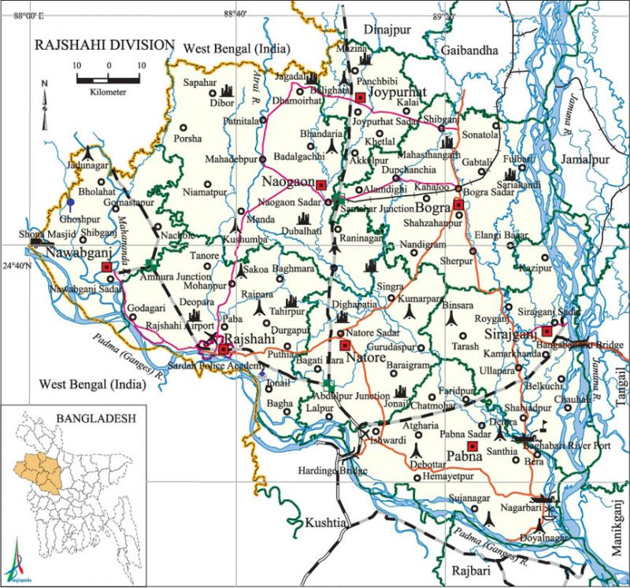
Map of Rajshahi Division

Slide 14
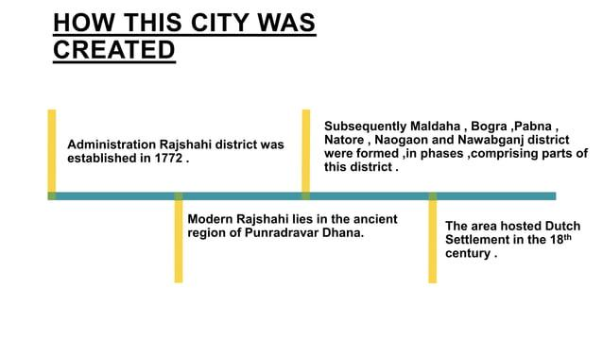

Slide 15
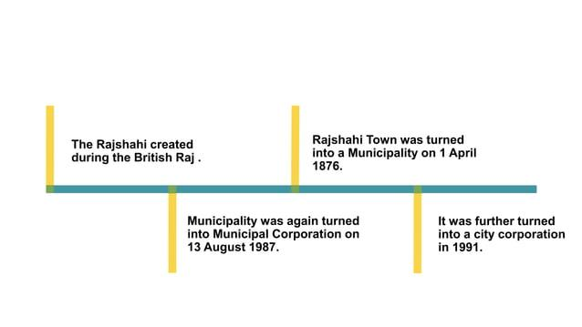

Slide 16

Educational institutions
The literacy rate of the Rajshahi city is 73.96%
Number of Educational institutions:
    University: 3; Medical college: 2
    College: 450; Law college: 7; Agriculture college: 1; Teachers training college: 17
    Polytechnic institute: 5
    Homeopathic college: 9
    Police academy: 1
    Primary teachers training institute: 1
    Institute of health technology: 1
    Survey institute: 1; Nursing institute 1
    Secondary vocational school 26
    Secondary school: 10123
    Primary school 13415
    Madrasa: 5013

Slide 17
Educational institutions
rajshahi university (1953),
Rajshahi University of Engineering and Technology (2003),
Pabna Science and Technology University (2008),
Rabindra University, Bangladesh (RUB)
Bogura Science and Technology University (BSTU)
Naogaon University
Varendra University
Khwaja Yunus Ali University
Ahsania Mission University of Science and Technology
Rajshahi Medical College (1962),
Shaheed Ziaur Rahman Medical College,
Azizul Haque College (Bogra),

Slide 18
Edward College (Pabna),
Rajshahi College (1873),
Sirajganj Government University College (1940),
Joypurhat Government College (1946),
Nawabganj Government college (1955),
Naogaon Government College (1962),
Ishwardi Government College (1963),
Rajshahi Cadet college (1966),
Nawabganj Government Mohila college (1966),’
Joypurhat Government Mohila College (1972),
Joypurhat Mohila Cadet College (2006),
Pabna Polytechnic Institute (1891),
Rajshahi Collegiate School (1828), Rajshahi Multilateral Girls' High School (1926), Rajshahi BB Academy (1898), Pabna Zila School (1853).

Slide 19

Main sources of income
Agriculture 59.35%, non-agricultural labourer 3.36%, industry 0.99%, commerce 14.25%, transport and communication 4.36%, service 8.97%, construction 1.45%, religious service 0.12%, rent and remittance 0.41% and others 6.74%.

Slide 20

Tourist Places in Rajshahi
Rajshahi, often referred to as the "Silk City" due to its historical significance in the silk trade, is a charming destination in northwestern Bangladesh. Renowned for its lush landscapes, vibrant culture, and historical landmarks, Rajshahi offers a blend of natural beauty and cultural heritage that appeals to travelers from all over the world.:

Slide 21

The Padma River
The river Padma is beautiful wherever you visit it. You may visit the mighty Padma by going to the T Dam or the I Dam. Both of these places offer a spectacular view of the river. A few kilometres to the west from the heart of the city, you can go to these places by rickshaw or an auto-rickshaw. If you wish, you can even go to one of the chars by hiring a boat or trawler that is waiting. A walk in on one of the chars will be a memory to cherish for a long time.

Slide 22
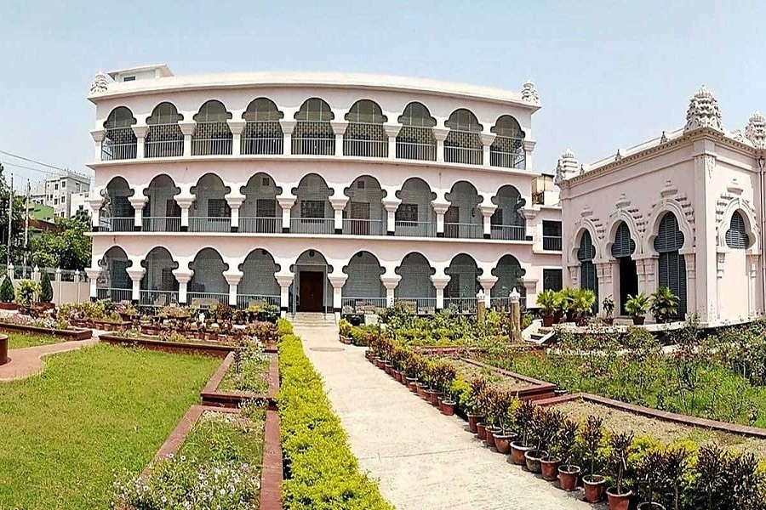
Varendra Research Museum
Located in the heart of Rajshahi University campus, the Varendra Research Museum is the oldest museum in Bangladesh and a treasure trove of archaeological artifacts, sculptures, coins, and manuscripts dating back to ancient times. Visitors can explore its extensive collection that provides insights into the region's rich history and cultural heritage.

Slide 23
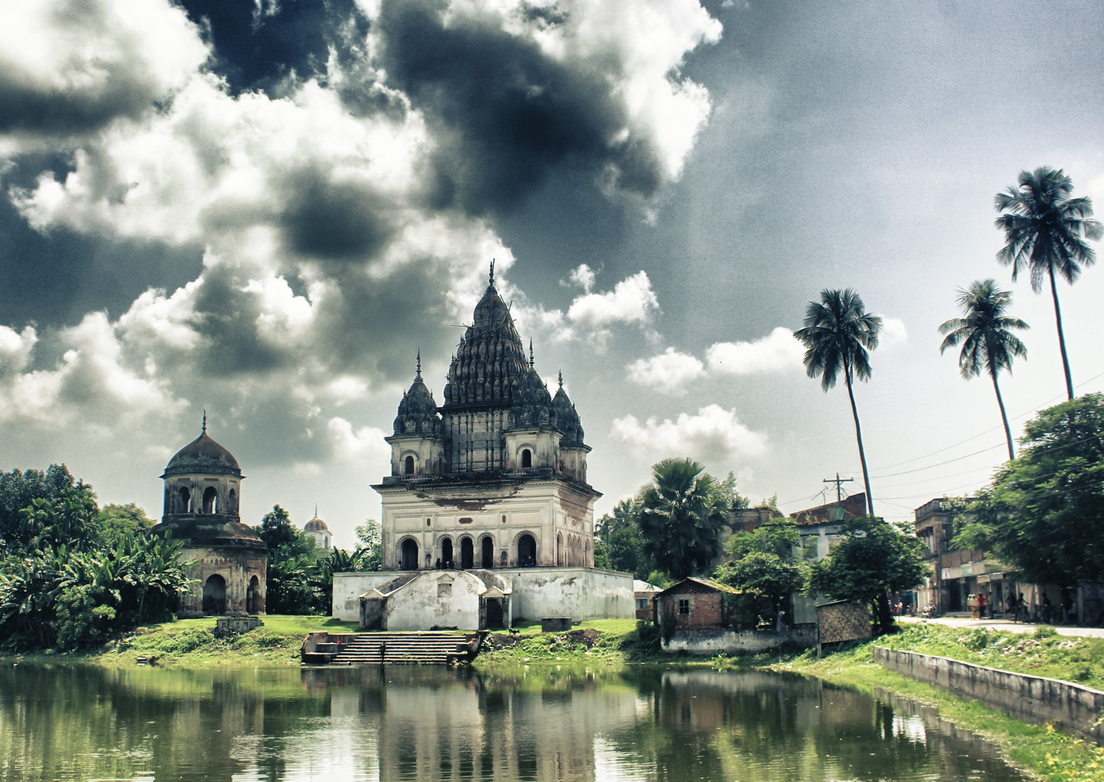
Puthia Temple Complex
Puthia, a small town near Rajshahi, boasts a remarkable collection of Hindu temples and palaces dating back to the 17th century. The Puthia Temple Complex includes the stunning Govinda Temple, Shiva Temple, and Jagannath Temple, showcasing exquisite terracotta sculptures and architectural grandeur.

Slide 24
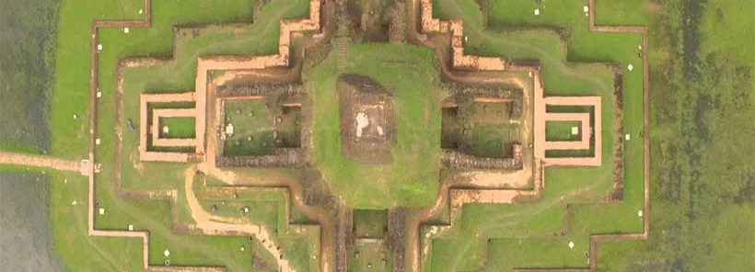
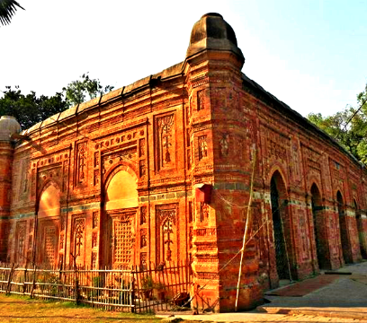
SOMAPURA MOHABIHAR
A UNESCO World Heritage site located in nearby Paharpur, Somapura Mahavihara is one of the most important archaeological sites in Bangladesh. This ancient Buddhist monastery, dating back to the 8th century, features a large central stupa surrounded by impressive ruins and intricately carved terracotta plaques.
BAGHA MOSQUE
Built during the Sultanate period in the early 16th century, the Bagha Mosque is renowned for its beautiful terracotta decorations and architectural elegance. It is a prime example of Islamic architecture in Bangladesh, attracting history enthusiasts and architecture aficionados.

Slide 25
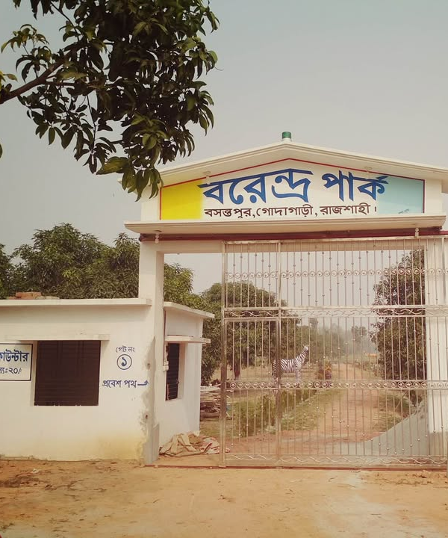
VARENDRA PARK
Varendra Park, located in Rajshahi city, is a popular recreational spot known for its serene lakes, lush greenery, and scenic beauty. It offers visitors a tranquil environment for picnics, leisurely walks, and boat rides, making it a favorite among locals and tourists alike.

Slide 26
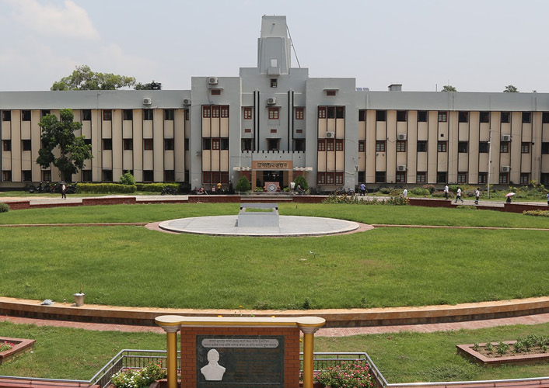
RAJSHAHI UNIVERSITY
Rajshahi University, one of the oldest and largest universities in Bangladesh, is renowned for its picturesque campus dotted with academic buildings, lush gardens, and ponds. The university's serene ambiance and historical significance attract visitors interested in academia and cultural exploration.

Slide 27
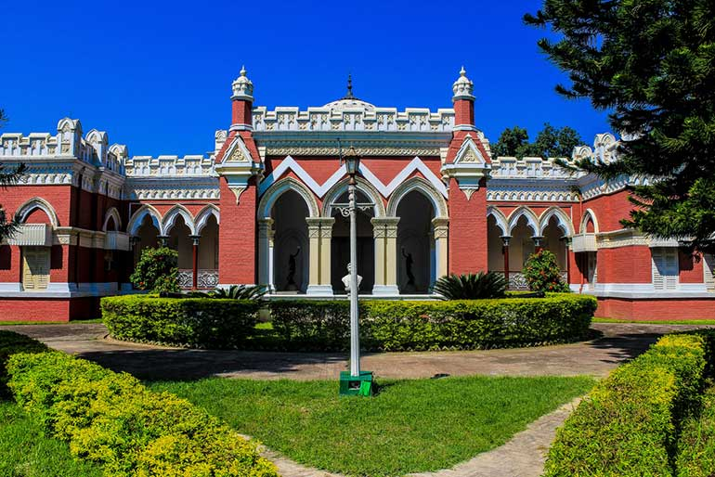
Dighapatia Rajbari
Dighapatia Rajbari, a historic palace located on the outskirts of Rajshahi city, offers a glimpse into the opulent lifestyle of the region's feudal lords during the British colonial era. The palace complex includes majestic buildings, manicured gardens, and a museum displaying royal artifacts and memorabilia.

Slide 28
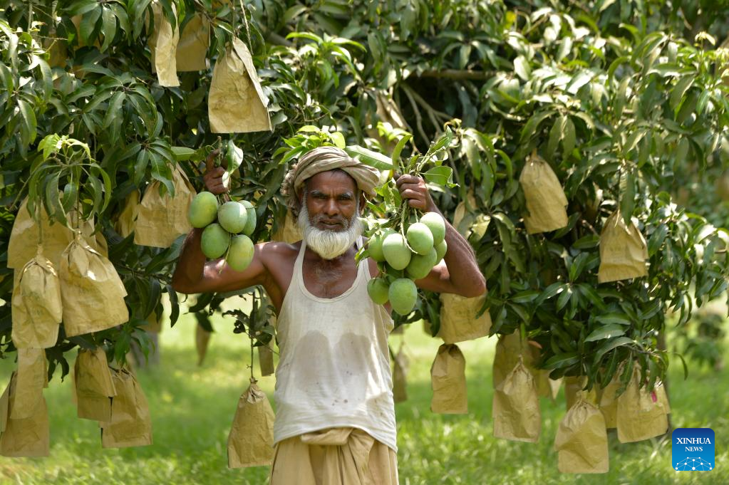
Chapai Nawabganj
Chapai Nawabganj, a district near Rajshahi, is home to the ancient ruins of Gauda, an ancient city dating back to the 7th century. Visitors can explore archaeological sites such as the Darasbari Mosque, Tahkhana Complex, and Gauda Fort, which reflect the region's historical and cultural significance.
chapainawabganj is known to fruit lovers for its variety of mangoes and is often referred to as the mango hub.

Slide 29
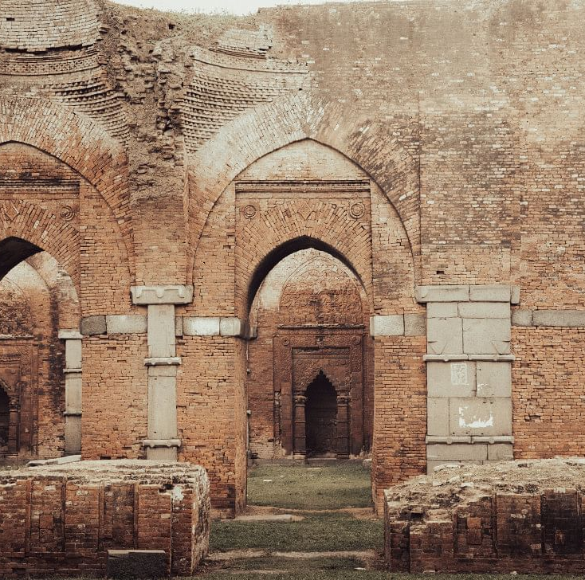
Darasbari Mosque
The complex was built in 1504. The square structure has remains of 40 large rooms, and is very reminiscent of Buddhist viharas with a central courtyard, and exemplifies a fine blending of Buddhist and Sultanate architecture.
Further into the orchard, keeping the water tank to the right, another short walk leads to the Darasbari Mosque. It is thought that Darasbari is a mutated version of 'Dars-bari,' or the house of teaching, as 'dars' is the traditional name for religious lessons in Islam in this region, and relates to the ruined educational complex nearby.

Slide 30
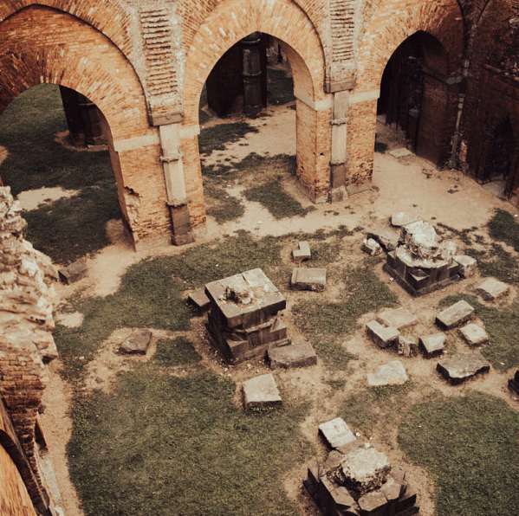
The mosque was constructed in 1479 AD by Shamsuddin Yusuf Shah of the Ilias Shahi dynasty, and is a great example of the architecture of Bengal Sultanate. While the roof and much of the walls are no longer there, due to the extensive damages caused by an earthquake in 1897, the layout of the building is grand in itself, and an imaginative visitor can enjoy the ambience and dive into what would have been a regular day for the people who lived here.

Slide 31
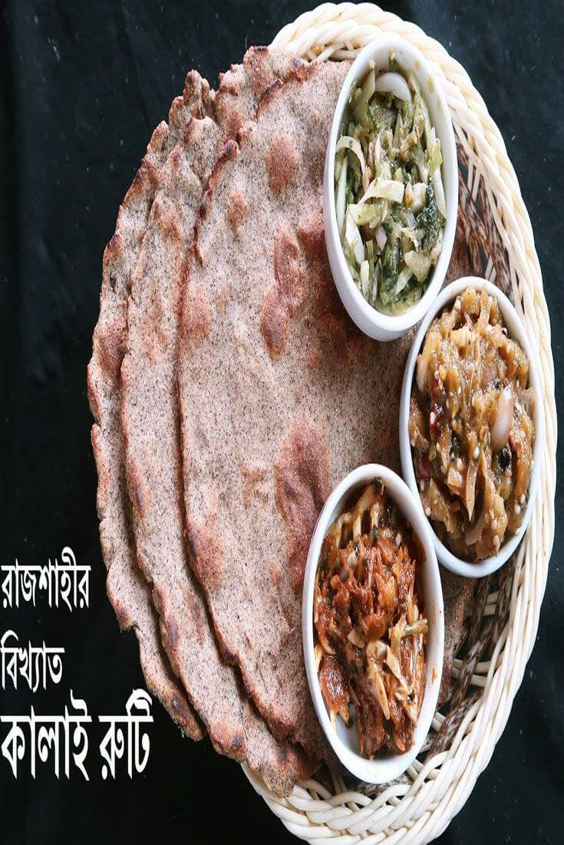
Kalo Bhuna: A flavorful and spicy goat meat curry, a popular dish in the region.
Chomchom: A syrupy sweet dessert that is a Rajshahi specialty.
Bhuna Khichuri: A spicy rice and lentil dish, a staple in Bangladeshi cuisine.
Kalai Ruti: A unique type of flatbread, often served with meat dishes or as a standalone snack.
Begun Bharta: An eggplant mash, a popular condiment often served with rice.
Nihari: A meat stew, particularly popular during the winter months, and is known for its marrow-rich gravy in Rajshahi.
Jhal Muri: A street food snack, similar to a savory mix, with added aloor chop (mashed potato) and peyanji (onion).

Slide 32
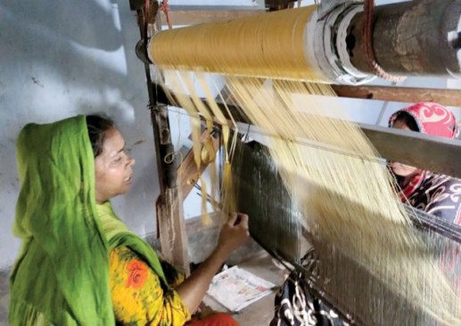
Rajshahi silk is the name given to the silk products produced in Rajshahi, Bangladesh. It is famous because it is a high-quality fabric used for clothing, especially for saris. In 2021, it was given Geographical indication status as a product of Bangladesh.

Slide 33
According to the Bangladesh Sericulture Board officials and researchers, the production of silk, a delicate and soft fiber produced from the cocoons of silkworms and is covered with a protein called sericin, began in the Indian subcontinent before the 13th century. Malda, Murshidabad, Nawabganj and Rajshahi of undivided Bengal turned into a silk hub due to their favourable weather condition.
Between the seventeenth and nineteenth centuries, silk production in the Bengal boomed as more silk was produced than needed locally, paving the way for trading both textiles and raw silk elsewhere.
Known as Bengal Silk it was one of the very few items to attract foreign traders to Bengal.
Before the partition of the Indian sub-continent in 1947, Boalia was the only trading centre in North Bengal for the silk yarn manufacturing industry, where 10 lakh people were directly involved.

Slide 34
Renowned Personality

Slide 35

Andrew Kishore
Andrew Kishore (1955-2020) a famous Bangladeshi playback singer. He was born on 4 November 1955 in Rajshahi city. His real name is Andrew Kishore Kumar Barai. Father’s name is Khitish Chandra Barai and mother’s name is Minu Barai. His music-loving mother’s favorite artist was Kishore Kumar, a renowned musician of the subcontinent. She named her son Kishore after her favorite artist. With the encouragement and inspiration of his mother, Andrew Kishore entered the world of music. He studied Management at Rajshahi University. He was taught music from the age of 6 under the guidance of Abdul Aziz Bachchu. Later, in 1977, he sang the song ‘Soheli O Soheli’ composed by Debu Bhattacharya in the talent hunt program organized by Bangladesh Betar and won the hearts of thousands of fans. After that, Bangladesh Betar enlisted him for Rabindra sangeet, Nazrul geeti, folk music, modern songs and patriotic songs.
Andrew Kishore was married to Lipika Andrew Eti. They have one daughter and one son. Artist Andrew Kishore passed away on 6 July 2020

Slide 36
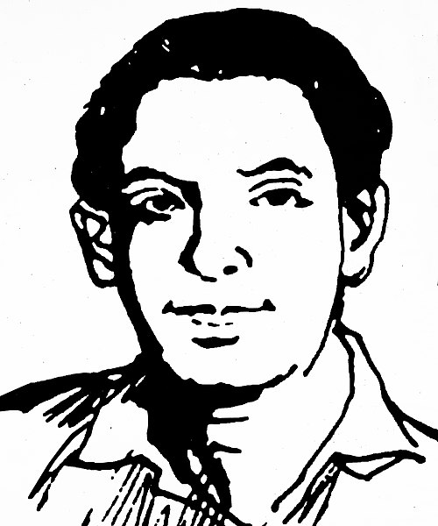
Mohammad Shamsuzzoha
Born | 1 May 1934 Onda, Bengal, British India
Died | 18 February 1969 (aged 34) Rajshahi, Present Bangladesh, ( Then East Pakistan)
Alma Mater | University of Dhaka Imperial College London
Occupation | Teacher
Movement | 1969 uprising in East Pakistan
Wife | Nilufar Zoha
Award | Independence Day Awardd

Slide 37

Mohammad Sabbir Rahman
Mohammad Sabbir Rahman (born 22 November 1991) is a Bangladeshi cricketer. He is from Rajshahi and besides the national team, he plays for Rajshahi Division in domestic cricket. He is a batter who occasionally bowls leg spin. He was the highest run scorer for a test playing nation in the 2016 Asia Cup and became man of the tournament. He made his international debut in February 2014
International career
One Day International
Sabbir made his One Day International (ODI) debut for Bangladesh against Zimbabwe on 21 November 2014.
On 23 February 2019, against New Zealand, Sabbir scored his maiden ODI century which was also his first ever century in international cricket.
Asia Cup 2016
Sabbir was the top run scorer for Bangladesh in 2016 Asia Cup. Sabbir was outstanding with the batting as he scored 176 runs with an average of 44.00 and strike rate of 123.94, and played a major part of Bangladeshi batting unit and was selected as 'Player of the series'.[6] He scored a fifty in the match against Sri Lanka, where it was the first time that Bangladesh beat Sri Lanka in a T20I.

Slide 38

Test cricket
On 20 October 2016, Sabbir made his Test debut against England.
2019 Cricket World Cup
In April 2019, Sabbir was named in Bangladesh's 15 man squad for 2019 Cricket World Cup.
BPL
He once held the record for the highest ever individual score in Bangladesh Premier League (BPL) history (122), until the record was beaten by Chris Gayle in the 2017 edition of the BPL.
In October 2018, he was named in the squad for the Sylhet Sixers team, following the draft for the 2018–19 Bangladesh Premier League. In November 2019, he was selected to play for the Cumilla Warriors in the 2019–20 Bangladesh Premier League.

Slide 39
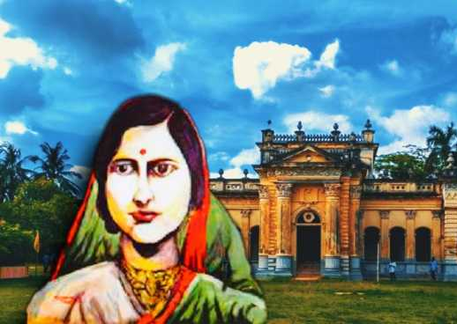
Rani Bhabani (1716–1803), also known as Ardhabangeshwari and Natorer Rani or the Queen of Natore, was a Hindu zamindar during the British colonial era in what is now Rajshahi, Bangladesh.^{[3]} She became the zamindar after the death of her husband Raja Ramkanta Moitra (Ray), 'Zamindar' of Natore estate.
The Rajshahi Raj or Natore estate was the largest zamindari which occupied a vast position of Bengal. The Natore estate had an area of nearly 32,970 square kilometres (12,731 sq mi) and included not only much of North Bengal but also large parts of the areas later comprising the administrative districts of Murshidabad, Nadia, Jessore, Birbhum and Burdwan. After the death of her husband, Rani Bhabani of Natore Rajbari, expanded both the estate and the palace.

Slide 40
She tried to bring social reform by introducing widow remarriage in society but was unsuccessful. During the Great Bengal famine of 1770, she helped the poor by hiring eight vaidyas to help the people at her own expense. Rani Bhabani's house in Natore remains a major tourist attraction in Bangladesh to date.
Rani Bhabani died in 1803, at the age of 79, 46 years after the Battle of Plassey.

Slide 41
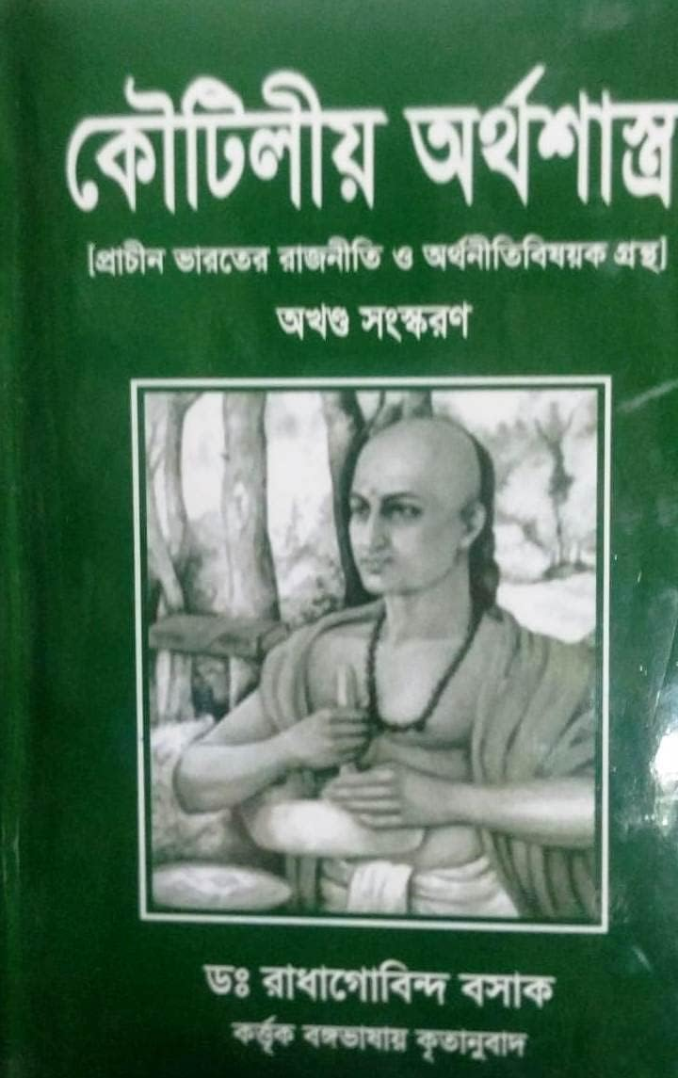
Radhagobinda Basak
(Born on 8 January 1885, died on 10 December 1982) In the early part of the twentieth century, among the few Bengali scholars who had the rare fortune of becoming legendary figures in the fields of Bengal’s history, archaeology, classical languages, and religious studies — Radhagobinda Basak was one of them. He translated Kautilya's Arthashastra into lucid Bengali prose. His translation remains the most reliable Bengali rendition of Kautilya’s Arthashastra.
He was honored with the title of Vidyavachaspati by Sanskrit College, Kolkata, and received a D.Litt. degree from Burdwan University. On 15 August 1965, the Government of India awarded him the highest Presidential honor.

Slide 42
https://www.thedailystar.net/life-living/travel/news/top-6-places-visit-rajshahi-city-3153066
https://www.rajshahi.gov.bd/bn/site/page/f3Fq-%E0%A6%AA%E0%A7%8D%E0%A6%B0%E0%A6%96%E0%A7%8D%E0%A6%AF%E0%A6%BE%E0%A6%A4-%E0%A6%AC%E0%A7%8D%E0%A6%AF%E0%A6%95%E0%A7%8D%E0%A6%A4%E0%A6%BF%E0%A6%A4%E0%A7%8D%E0%A6%AC
https://rmgbd.net/2022/05/silk-is-in-a-sorry-state/
https://textilefocus.com/rajshahi-silk-stunning-raw-materials-fashion-industry/
https://www.thedailystar.net/life-living/travel/news/seeking-relics-bengal-sultans-the-darasbari-mosque-and-complex-3125596
https://en.banglapedia.org/index.php/Ray,_Saratkumar

